Slide 1
Iteration 2
Team 6:
Hannah Nguyen
Puskar Dev
Safi Ullah

Slide 2
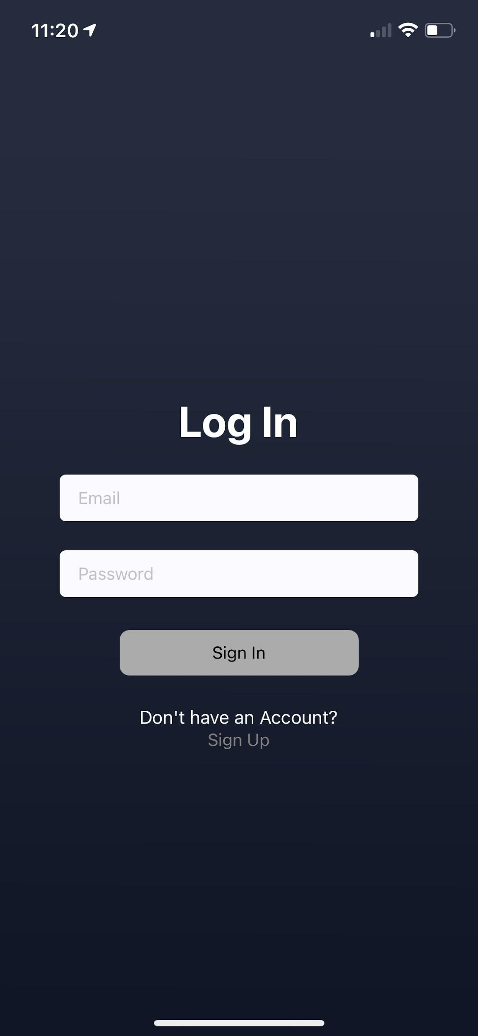
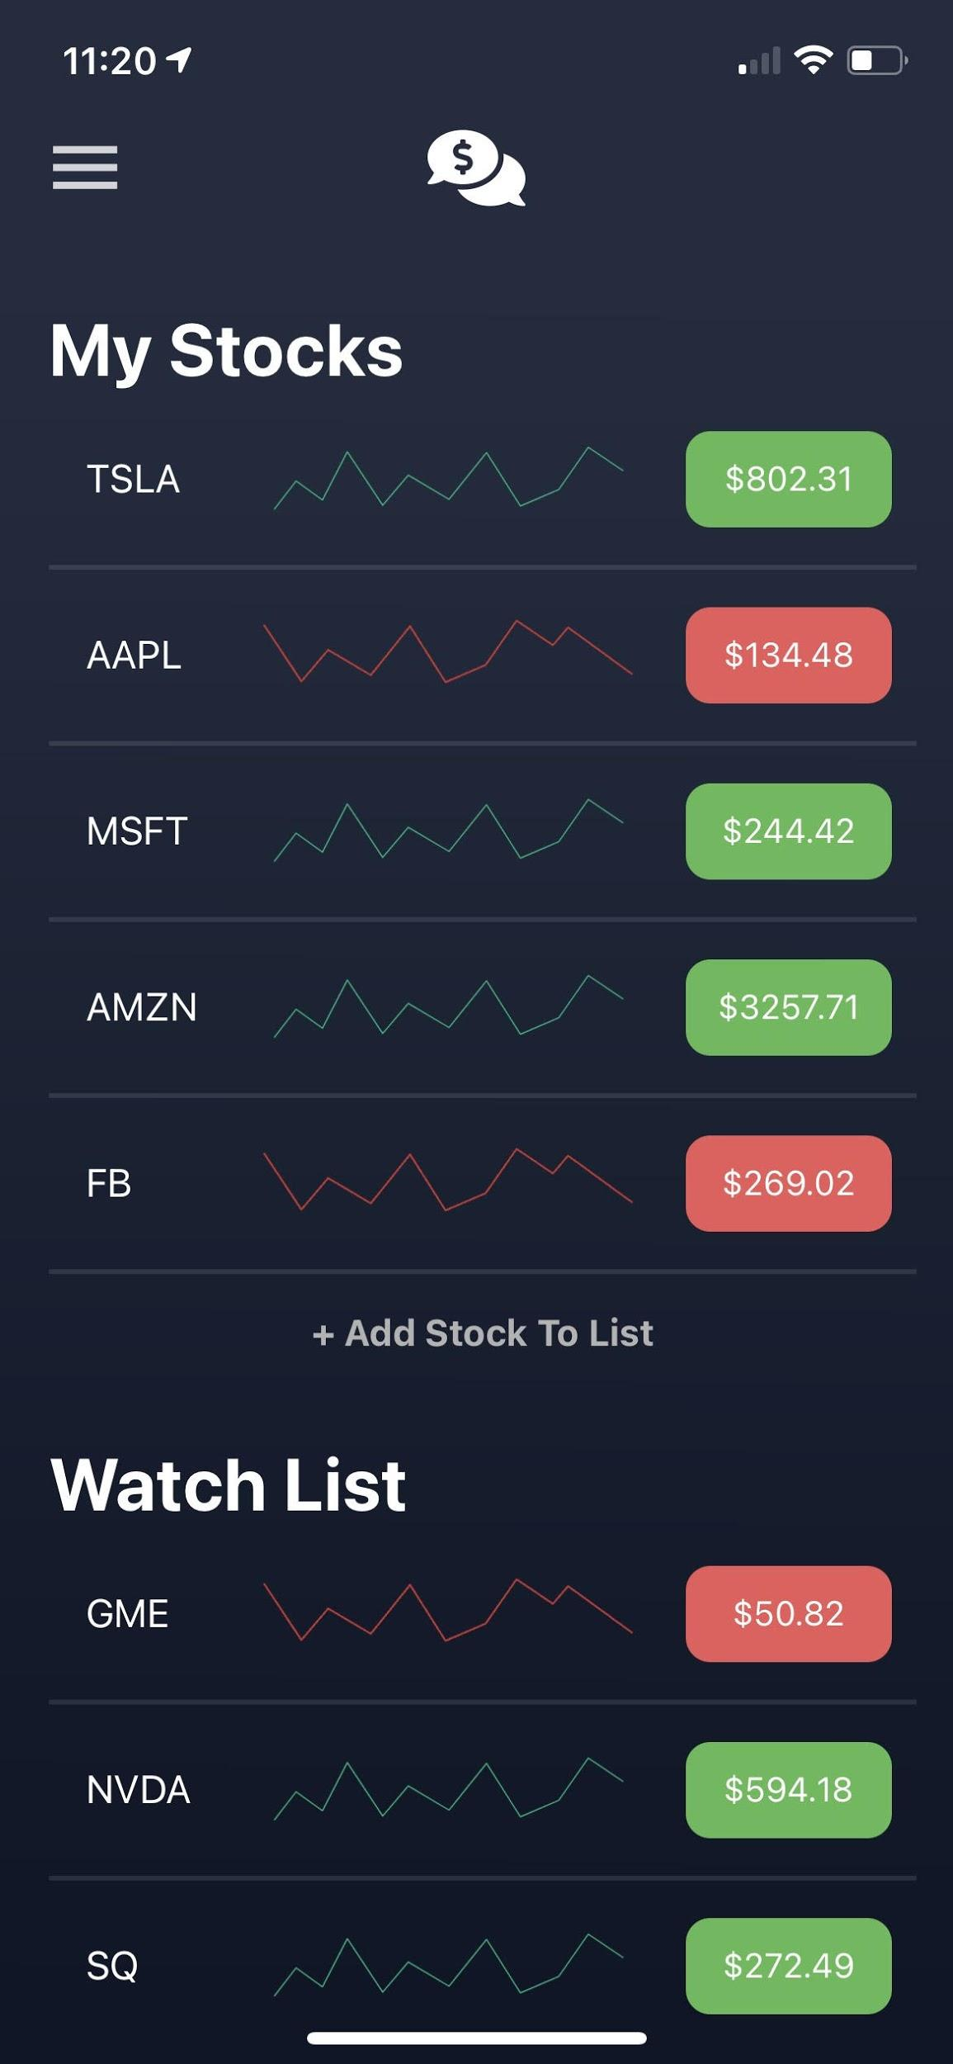
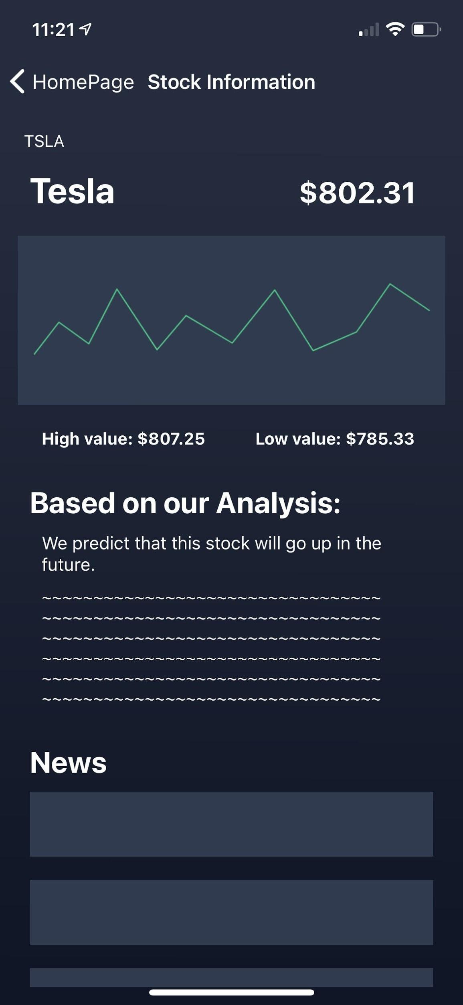
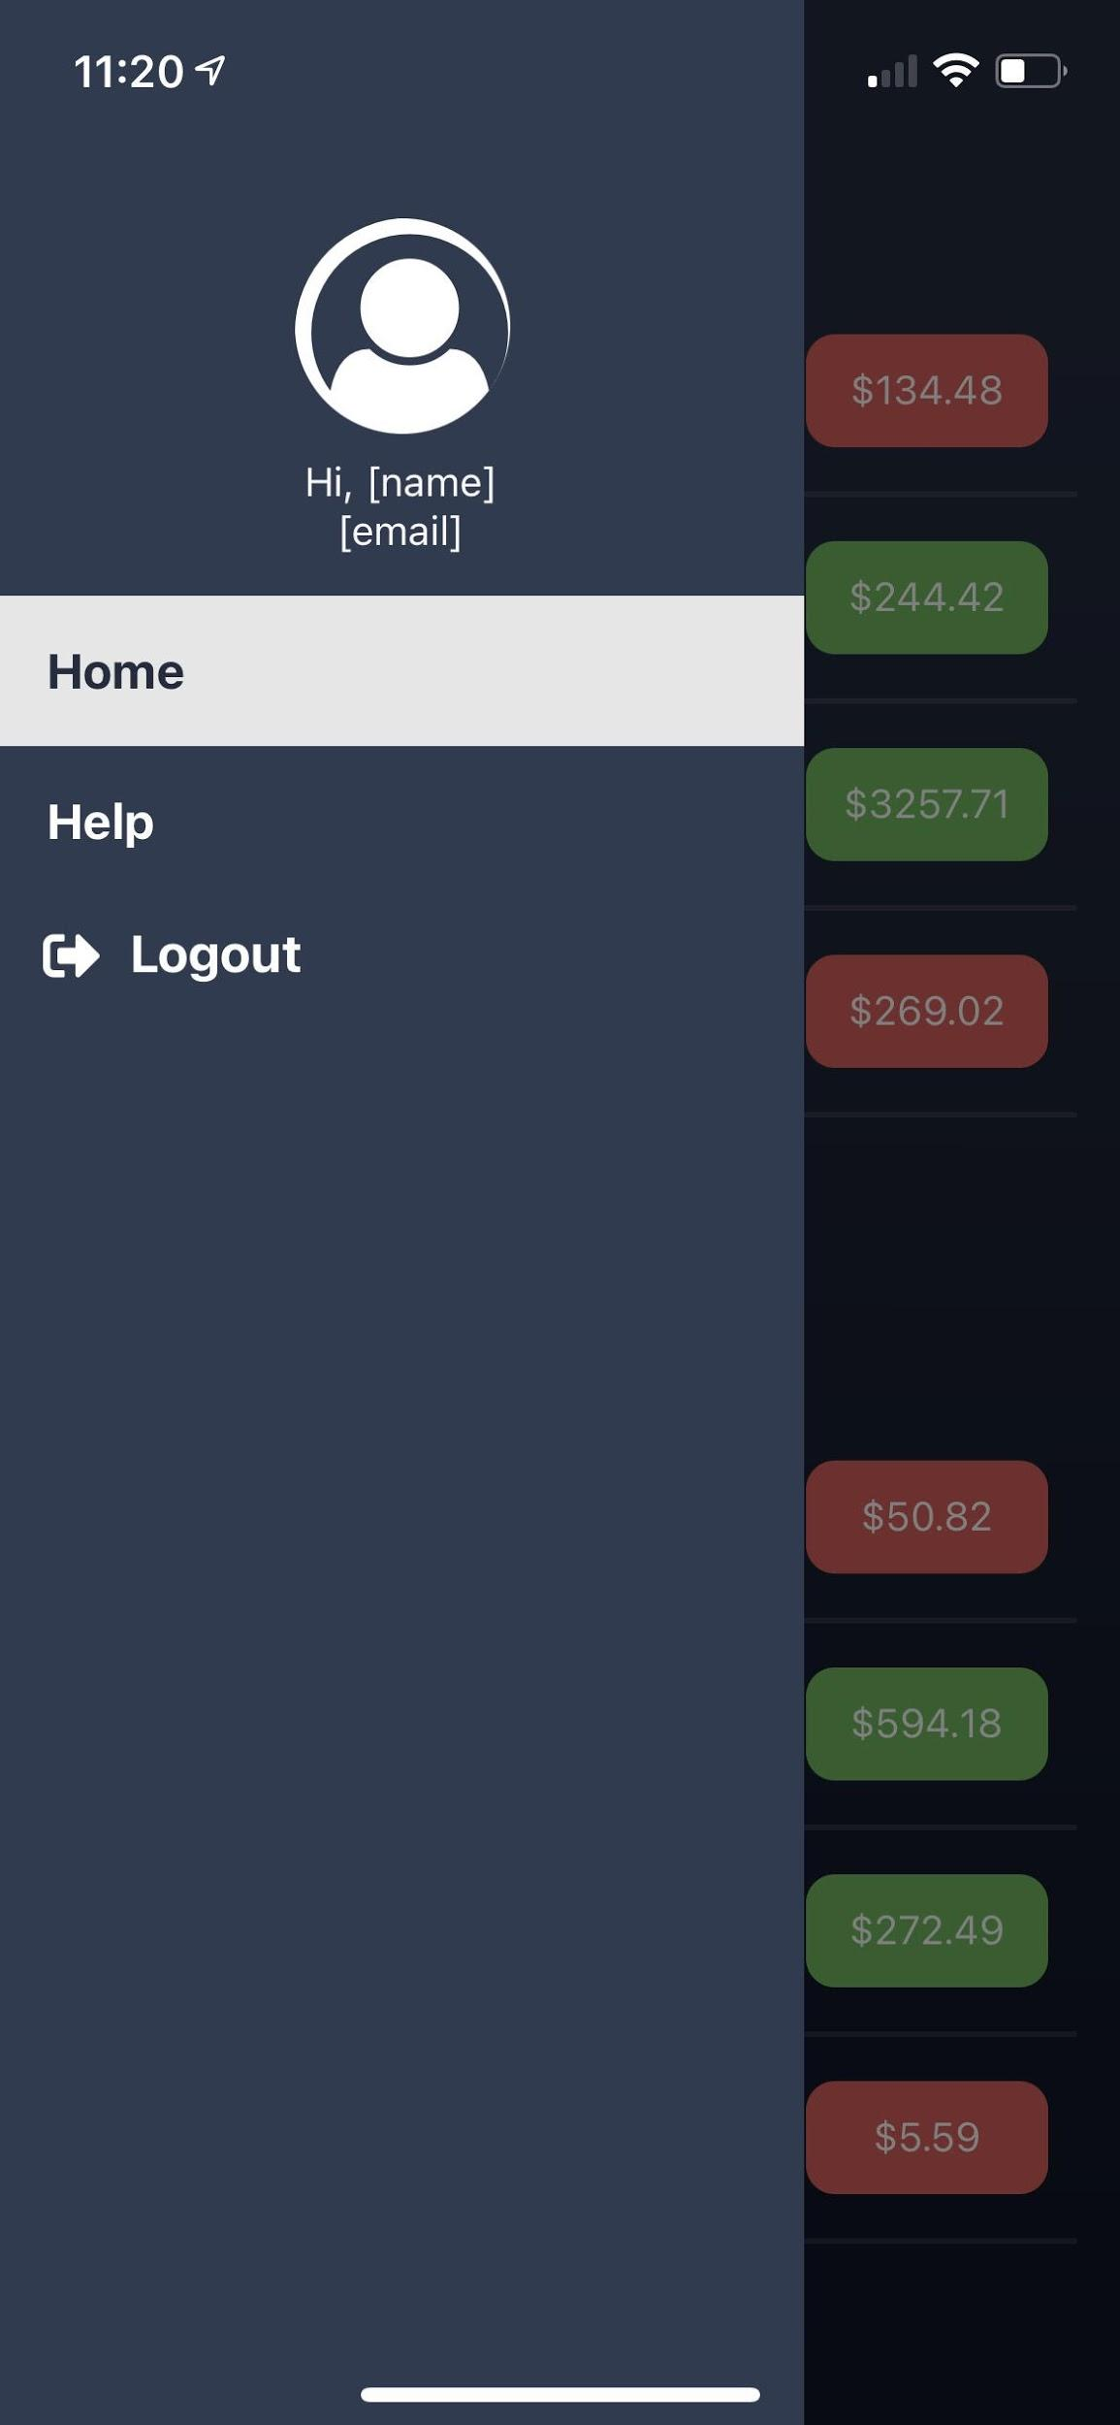
1
UI Screenshots

Slide 3
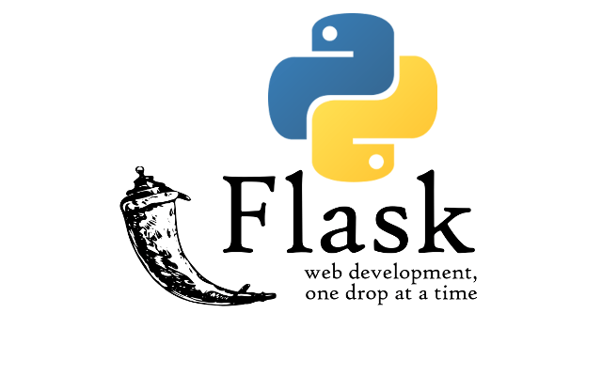
2
Backend
Python with Flask
Flask is a micro web framework written in Python.
REST API’s to communicate between front-end and back-end
React Native provides the Fetch API for networking.

Slide 4
3
Backend
Fetch API on React-native will make a POST request to flask server passing the stock ticker (e.g. TSLA)
Then, the server will do the necessary processing/analysis and send back a JSON response to front-end.
The necessary information from the response will be extracted and delivered to the user.

Slide 5
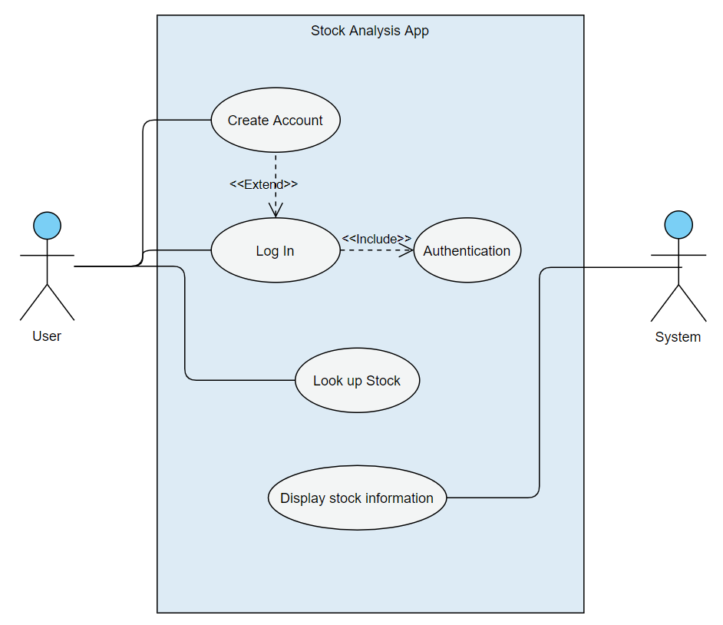
4
Use Case

Slide 6

Risks & Challenges
5
Debugging errors in emulator
Connecting backend with front-end
Changing styles for data and API’s
TIME

Slide 7

6
Future development plans
Connect backend code to front end
Write the User Agreement Contract
Analysis on data from Yahoo finance

Slide 8
7
User Feedback
Feedback | Status
On the homepage, there is confusion between the different lists, “My Stocks” and “Watch List” | In-Progress
The wording in the “Based on our analysis” section in the stock information page should be chosen carefully, since it is illegal to suggest or give advice on selling stocks. | Complete
For users who are new to investing in stocks, most information on the app may not make any sense to them since they are technical. | In-Progress

Slide 9
Github Link
Google Form for Feedback
8
https://github.com/puskardev/StockApp
https://forms.gle/nAjV5nnZGZk8gn766

Slide 10
THANKS!
Does anyone have any questions?

